Slide 1
Spike Sorting Project
CMSC 635
Knowledge Discovery & Data Mining
Christina Early
&
Hank St. Laurent

Slide 2
Understanding Problem Domain
Decided to use data given for project
Reviewed
  Methods for spike sorting - Michael Lewicki
  Techniques for spike sorting - Chris Pouzat
Reviewing other resources on line
  Automatic Spike Sorting – F. Wood
  Spike Sorting Neural Signals

Slide 3
Understanding Data
Downloaded WEKA
  Still learning its capabilities
Deciding whether to use
  MATLAB or WEKA
Analyzing data with both
Plotted data for both clusters

Slide 4
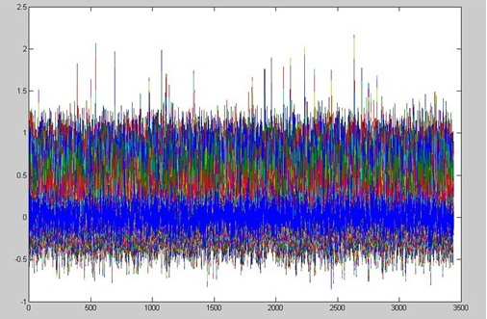
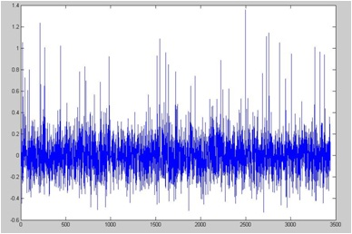
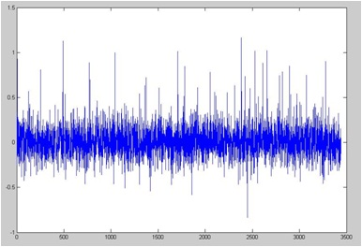
Data
Cluster 1
All 64 Features
Feature 1
Feature 64

Slide 5
Data Cluster 1
Mean
  F1 =0 .0035
  F64 = 0.0122
Max Value
  F1 = 1.3572
  F64 = 1.1670
Min Value
  F1 = -0.5268
  F64 = -0.8344

Slide 6
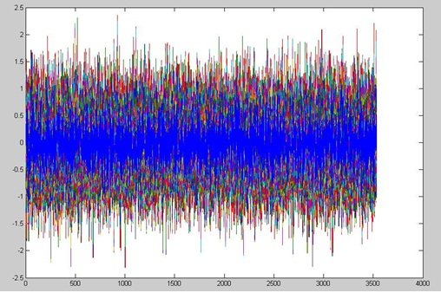
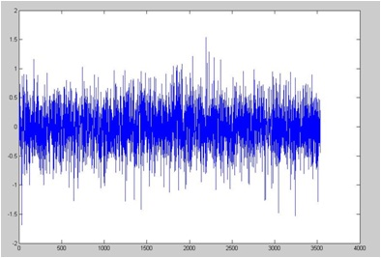
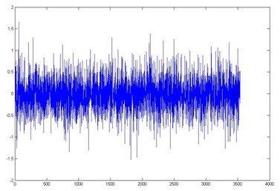
Cluster 2
All 64 Features
Feature 1
Feature 64

Slide 7
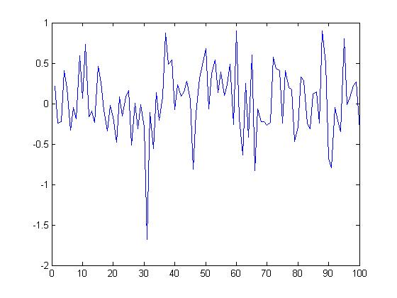
Cluster 2 F 1 to 100

Slide 8
Data Cluster 2
Mean
  F1 =0 .0140
  F64 = 0.0229
Max Value
  F1 = 1.5393
  F64 = 1.6591
Min Value
  F1 = -1.6832
  F64 = -1.5213

Slide 9
Research
Preprocessing
  Weka Features
Feature Extraction techniques
  PCA, Fisher, Fourier
Clustering
  Partition, Hierarchical, Scalable, Model
Classification

